Slide 1
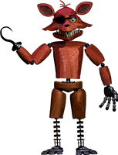

PIRATE LAZER SIMULATOR

Slide 2


Slide 3
move

Slide 4
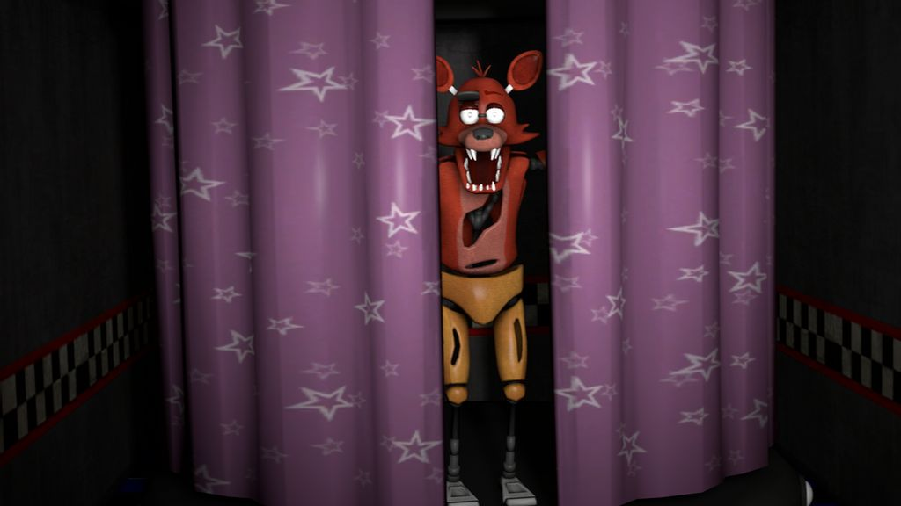

Slide 5
move

Slide 7
move

Slide 8
JUMPSCARE

Slide 10
PLAY
MY OTHER
GAMES TOO

